Slide 1

SFWRENG 4GC3 Sensory Perception, Cognition and Human/Computer Interfaces for Game Design
18 - Innovation Danny Papagiannis
Acknowledgement: Parts of these lectures are based on material prepared by Michael Porter, HBS, and are used herein under a creative commons license

Slide 2
Studies in Innovation
What is Innovation?
Disruptive Innovation
Innovator’s Dilemma
Gartner Hype Cycle
Article: MIT/Sloan – 12 Different Ways for Companies to Innovate
Case Studies:
Xerox Parc
Apple
Commodore Amiga and PC’s

Slide 3
Innovation
What is Innovation?
Do the most innovative products succeed?
Why or why not?
Does Innovation involve something new?

Slide 4
Disruptive Innovation (Christensen 1997)
The theory explains the phenomenon by which an innovation transforms an existing market or sector by introducing simplicity, convenience, accessibility, and affordability where complication and high cost are the status quo.
Initially, a disruptive innovation is formed in a niche market that may appear unattractive or inconsequential to industry incumbents, but eventually the new product or idea completely redefines the industry.
http://www.christenseninstitute.org/key-concepts/disruptive-innovation-2/

Slide 5
Disruptive Innovation
Video
https://www.youtube.com/watch?v=WxwR_TTuKdc&feature=youtu.be
https://www.youtube.com/watch?v=qDrMAzCHFUU

Slide 6
Innovator’s Dilemma
Christensen (1997) - Innovator's dilemma" being ahead of their time in an embryonic market that was not quite ready

Slide 7
Gartner Hype Cycle
“Gartner Hype Cycle methodology gives you a view of how a technology or application will evolve over time..”
“Hype Cycles provide a graphic representation of the maturity and adoption of technologies and applications, and how they are potentially relevant to solving real business problems and exploiting new opportunities”.
https://www.gartner.com/en/research/methodologies/gartner-hype-cycle

Slide 8
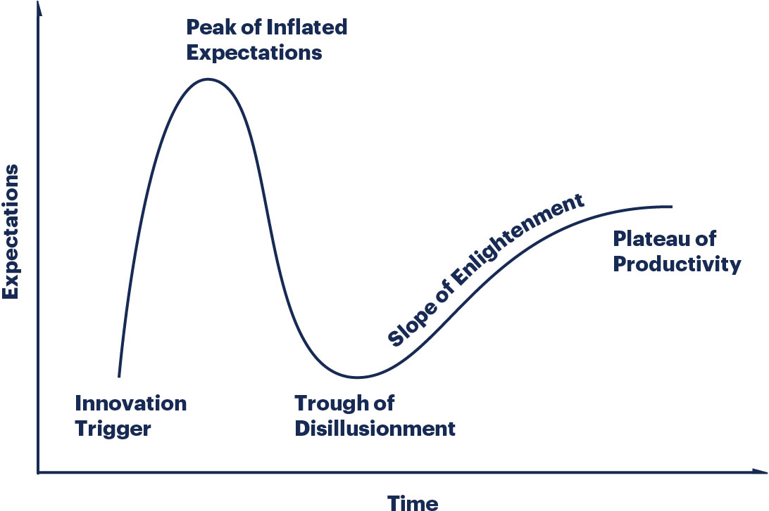
Gartner Hype Cycle
https://www.gartner.com/en/research/methodologies/gartner-hype-cycle

Slide 9
Gartner Hype Cycle
Innovation Trigger: A potential technology breakthrough kicks things off. Early proof-of-concept stories and media interest trigger significant publicity. Often no usable products exist and commercial viability is unproven.
https://www.gartner.com/en/research/methodologies/gartner-hype-cycle

Slide 10
Gartner Hype Cycle
Peak of Inflated Expectations: Early publicity produces a number of success stories — often accompanied by scores of failures. Some companies take action; many do not.
https://www.gartner.com/en/research/methodologies/gartner-hype-cycle

Slide 11
Gartner Hype Cycle
Trough of Disillusionment: Interest wanes as experiments and implementations fail to deliver. Producers of the technology shake out or fail. Investments continue only if the surviving providers improve their products to the satisfaction of early adopters.
https://www.gartner.com/en/research/methodologies/gartner-hype-cycle

Slide 12
Gartner Hype Cycle
Slope of Enlightenment: More instances of how the technology can benefit the enterprise start to crystallize and become more widely understood. Second- and third-generation products appear from technology providers. More enterprises fund pilots; conservative companies remain cautious.
https://www.gartner.com/en/research/methodologies/gartner-hype-cycle

Slide 13
Gartner Hype Cycle
Plateau of Productivity: Mainstream adoption starts to take off. Criteria for assessing provider viability are more clearly defined. The technology's broad market applicability and relevance are clearly paying off.
https://www.gartner.com/en/research/methodologies/gartner-hype-cycle

Slide 14
Gartner Hype Cycle
https://www.youtube.com/watch?v=2e416wjdKaY

Slide 15
MIT – Sloan – 12 Different Ways for Companies to Innovate
Business innovation’’ is far broader in scope than product or technological innovation
Technological innovation in the laboratory does not necessarily translate into customer value

Slide 16
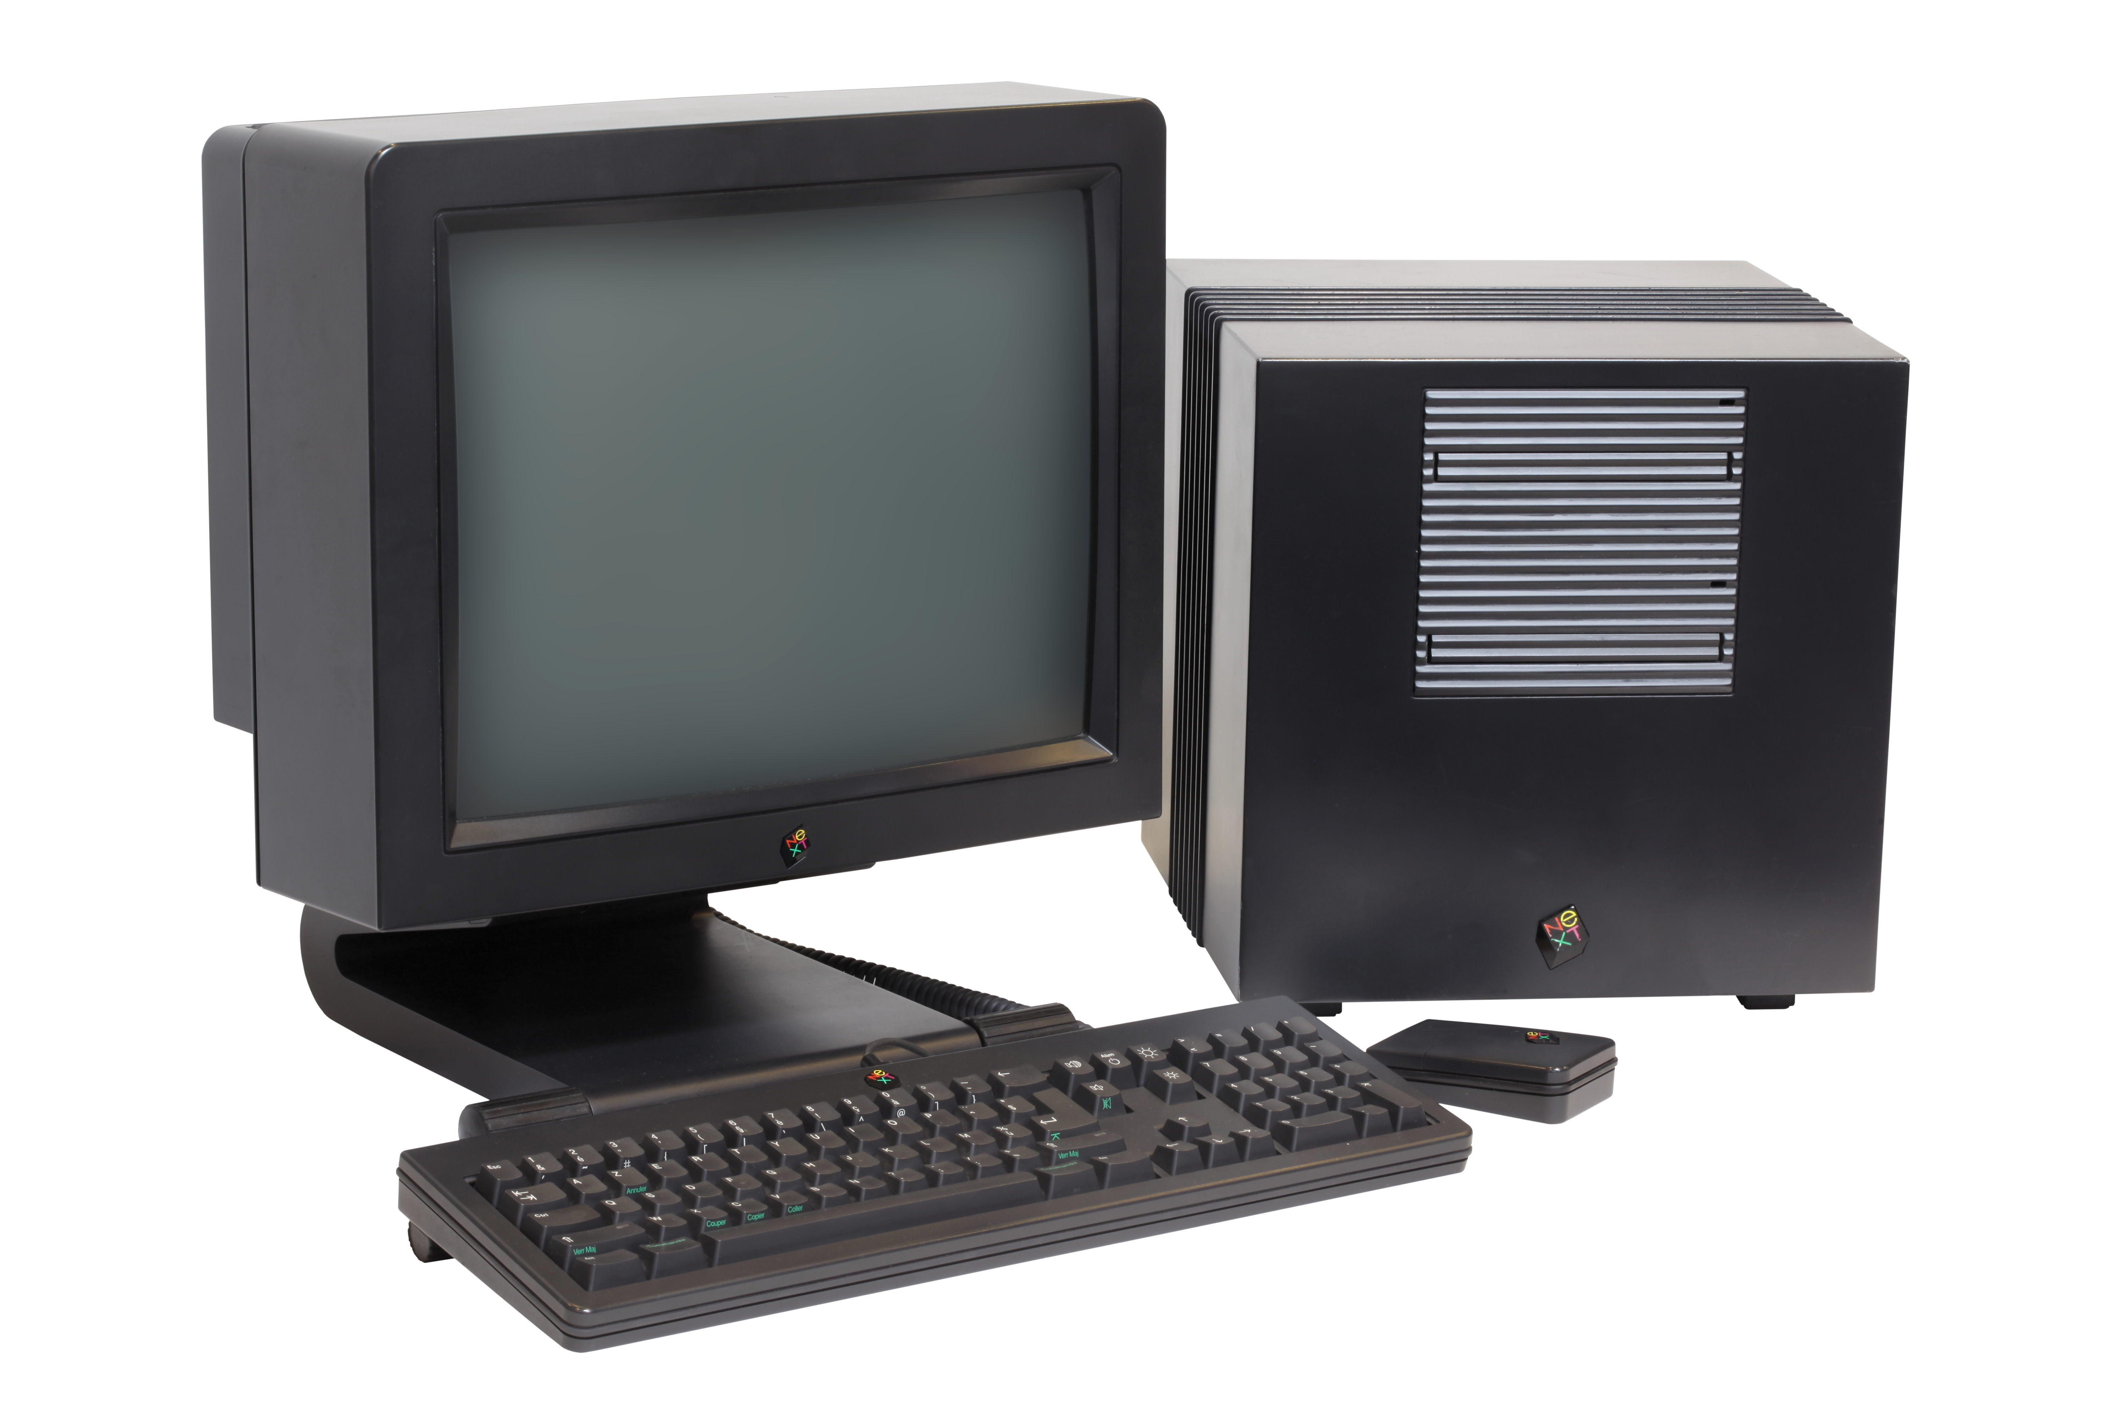
NeXT Computer
https://upload.wikimedia.org/wikipedia/commons/9/9d/NEXT_Cube-IMG_7154.jpg

Slide 17
Case Study: Next Computers
Founded by Steve Jobs
Introduced a host of technological advances
Multimedia, Innovative Operating System, High Resolution Graphics, Magnetic Optical Storage
Not commercially successful

Slide 18
Case Study: Next
Why wasn’t Next commercial successful?
High Cost
Few software applications were available
Too radical for it’s time
Who was the market? Predominately schools/educational institutions
BUT the NextStep OS was used as the basis for Mac OS X

Slide 19
Defining Business Innovation
We define business innovation as the creation of substantial new value for customers and the firm by creatively changing one or more dimensions of the business system

Slide 20
3 Important Characterizations
Business Innovation is About New Value, Not New Things.
Innovation is relevant only if it creates value for customers — and therefore for the firm. Thus creating “new things” is neither necessary nor sufficient for business innovation.

Slide 21
3 Important Characterizations
Business Innovation Comes in Many Flavors
Jet Blue
Home Depot

Slide 22
3 Important Characterizations
Business Innovation is Systemic
Successful business innovation requires the careful consideration of all aspects of a business

Slide 23
Innovation Radar
This tool presents and relates all of the dimensions through which a firm can look for opportunities to innovate.
Developed 4 key dimensions that serve as anchors

Slide 24
Innovation Radar
(1) the offerings a company creates – What
(2) the customers it serves - Who
(3) the processes it employs - How
(4) the points of presence it uses to take its offerings to market - Where
Eight other dimensions of the business system that can serve as avenues of pursuit for a total of 12

Slide 25
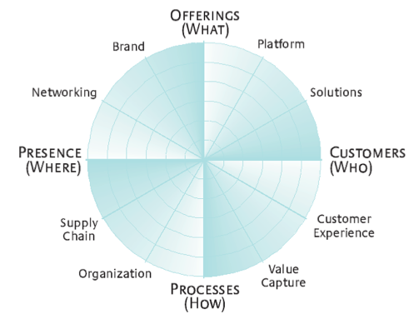
Innovation Radar
http://sloanreview.mit.edu/article/the-different-ways-for-companies-to-innovate/

Slide 26
Innovation Radar
http://sloanreview.mit.edu/article/the-different-ways-for-companies-to-innovate/

Slide 27
Innovation Radar: Apple Computer
Its famously successful iPod is more than a nifty product.
It is also an elegant solution for customers (simple, integrated buying and consumption of digital music), content owners (secure pay-per-song model for legal music downloads) and its manufacturer (the discovery of new growth markets).

Slide 28
Innovation Radar: Apple Computer
Apple attacked not only the offerings and platform dimensions but also:
Supply Chain (content owners)
Presence (portability of a customer’s entire collection of music, photos and videos) networking (connecting with Mac or Windows computers)
Value Capture (iTunes)
Customer Experience (the complete iPod experience)
Brand (extending the Apple brand

Slide 29
Xerox Parc
“Xerox could have owned the entire computer industry… could have been the IBM of the nineties… could have been the Microsoft of the nineties.” – Steve Jobs

Slide 30
Xerox Palo Alto
Xerox “invented” or at least built computers that implemented the following concepts
Ethernet and Networking
GUI Displays and a Mouse
Desktop Publishing
Object Orientated Programming
Client/Server Computing
Laser Printing

Slide 31
Xerox Palo Alto
While seen as a commercial failure, the reality is that Xerox made over $100 million by commercializing it’s laser printing business
Microsoft, Apple, and other companies took advantage of the technology that Xerox had developed
Jobs is accused of stealing the ideas for the Apple Mac

Slide 32
Xerox Palo Alto: Analysis
Xerox was able to innovate by creating new products
But Xerox was unable to innovate in a business sense
The question becomes why?
Difficult question to answer, in reality there are probably many different reasons
Xerox saw itself as a copier company not as a computer company
Apple no longer sees itself as just a computer company

Slide 33
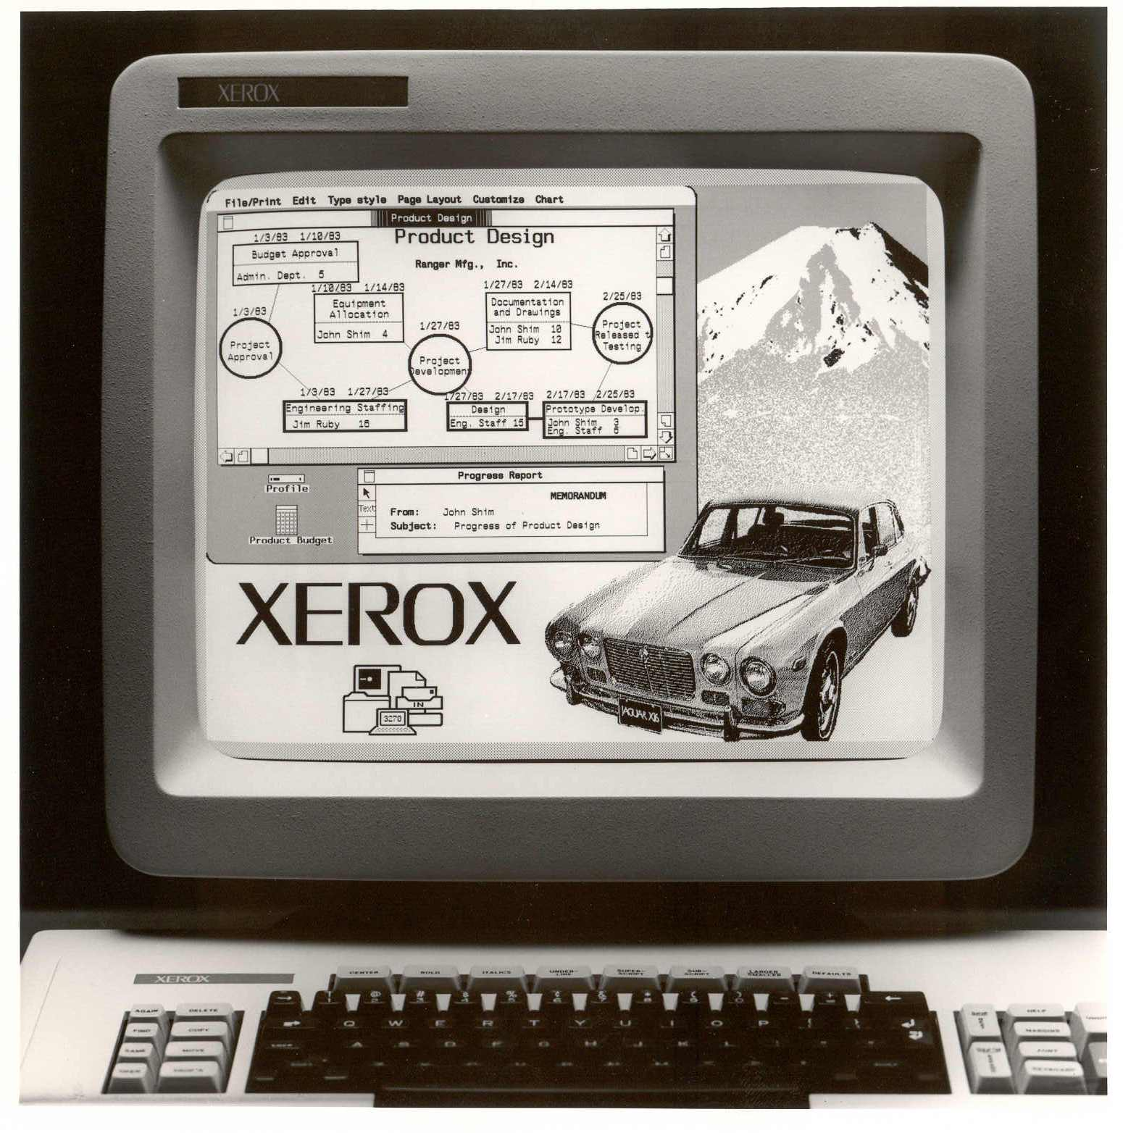
Xerox Star
http://www.digibarn.com/collections/screenshots/xerox-star-8010/

Slide 34
Xerox Star - 1981
Built upon the ideas of the Xerox Alto in the 70’s
Originally sold not just one computer but an entire document system centered around a laser printed connected to other systems over the Internet
Targeted corporations
$200K for a single system, $40K for each additional workstation

Slide 35
Xerox Star
Expensive
No clear user base
Not marketed properly
No sales commission for Xerox Star as there was for copiers
Slow, crashes took hours to fix
Even Xerox didn’t understand the system
IBM PC’s were cheaper, no GUI or mouse, but got the job done
Not IBM PC Compatible

Slide 36
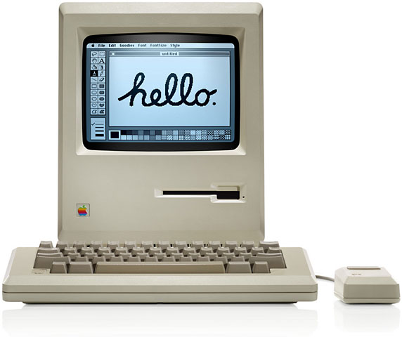
Apple Mac
http://lowendmac.com/wp-content/uploads/mac-128k.jpg

Slide 37
Apple Mac
Originally introduced in 1984 for $5700
Not Apple’s first GUI system – Apple Lisa introduced earlier
Substantially cheaper than the Xerox Star
But also a different market
How did Apple innovate?

Slide 38
Apple Mac and MIT/Sloan Model
Offerings: New product or service – stand alone GUI
Platform – Xerox Mouse cost $250 and lasted 2 weeks – Apple Mouse cost $15
Solutions – Desktop Publishing and Laser Printing
Customers – Mass Market – Artists – Schools – Print Shops

Slide 39
Apple Mac and MIT/Sloan Model
Customer Experience – GUI based environment
Value Capture – Continue Apple II model of creating and selling own software – MacWrite and MacDraw – later ported to Apple II
Processes – Redesigned OS that didn’t require typing or a command line
Brand – Apple Mac – Superbowl Ad

Slide 40
Case Study: Multimedia Computers

Slide 41
Multimedia Computers of the 1980’s
The first true multimedia computers
Capable of displaying and editing still images, audio, and certain forms of digital video
Devices existed that could convert existing analog video to digital – Analog to Digital Conversion
Digitizers. Originally slow scan

Slide 42
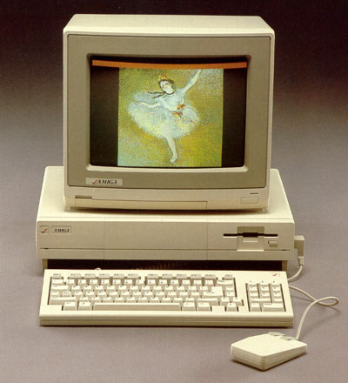
Amiga (1985)
https://upload.wikimedia.org/wikipedia/commons/2/26/Amiga_1000.jpg

Slide 43
Amiga (1985)
16 Bit Computer
Multitasking Operating System
Could display 4096 colours at once
8 Bit Stereo Sound
8mhz 68000 Motorola
512K later 1MB
20 years ahead of its time
The most advanced computer of the 1980’s
The most advanced gaming machine for many years

Slide 44
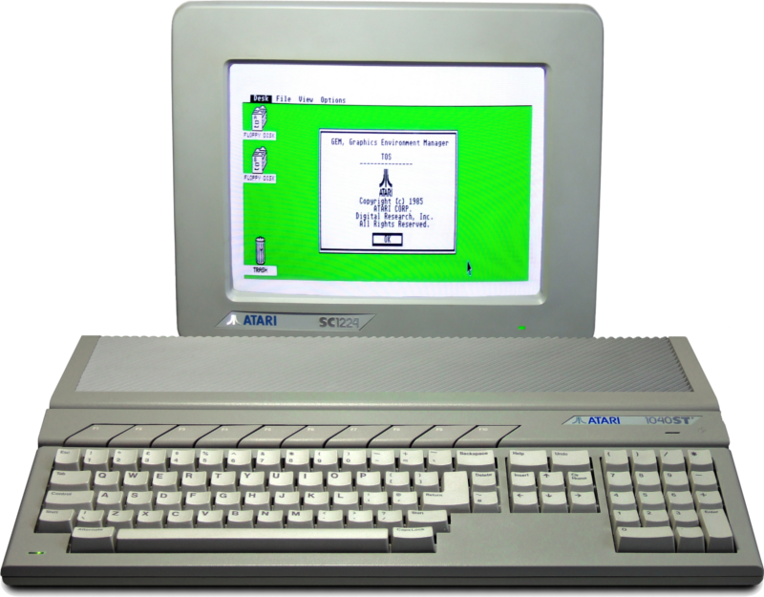
Atari ST (1985)
https://upload.wikimedia.org/wikipedia/commons/3/39/Atari_1040STf.jpg

Slide 45
Atari ST (1985)
68000 Motorola
16 Bit Computer
MIDI chip for Keyboard and Instruments
Maximum 512 Colours at Once
512K of Ram later 1MB

Slide 46
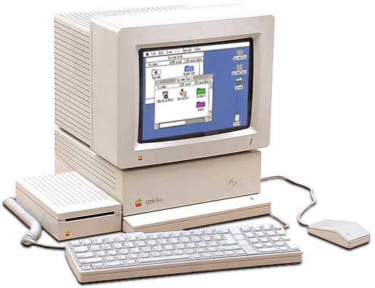
Apple IIGS (1986)
http://www.oldcomputers.net/pics/appleiigs.jpg

Slide 47
Apple IIgs (1986)
Advanced Ensoniq Sound Chip used in Keyboards
4096 Colours Max
Z80 Processor
2.8Mhz
256k ram later 1MB

Slide 48
Mid to late 80’s Multimedia
2D and 3D Animation
Photographic Editing software
Devices capable of digitizing images
MIDI Music Software
Some video editing
Digitized speech, digital music, digitized images in games

Slide 49
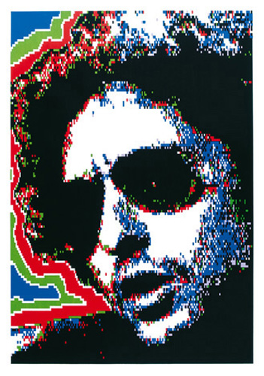
Digitized Image Apple II (1983)
http://www.sturejohannesson.com/charlotte/dylan.jpg

Slide 50
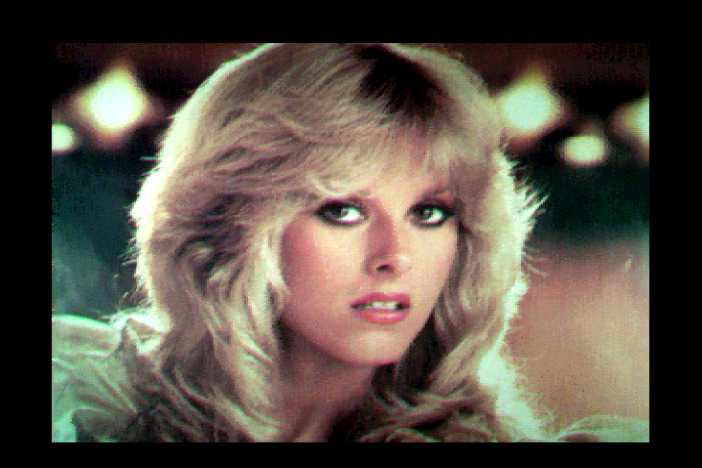
Digitized Image Amiga (1985)
http://amiga.filfre.net/wp-content/uploads/2011/10/066.png

Slide 51
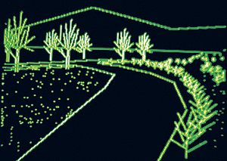
Computer Graphics Apple II (1983)

Slide 52
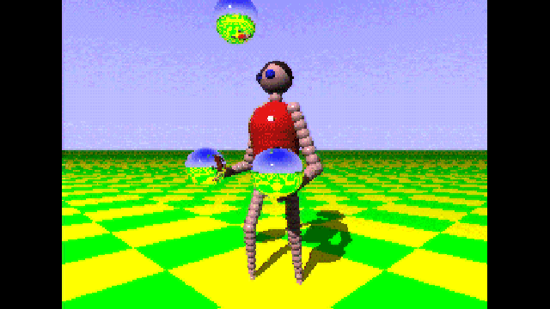
Computer Graphics Amiga (1985)
http://meatfighter.com/juggler/amiga00.png

Slide 53
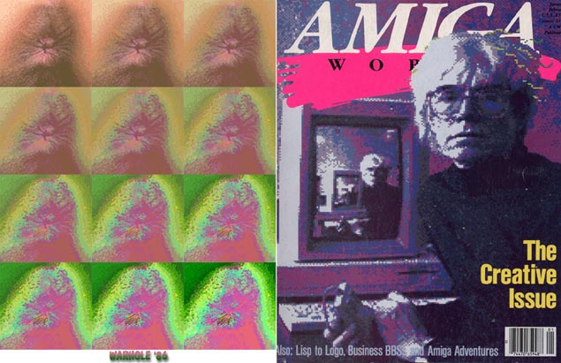
Digital Photography: Digital Photography as Art (1985)
http://www.randelshofer.ch/animations/anims/jamesalanpatterson/amiga.emugaming.com/aworld1cover.jpg

Slide 54
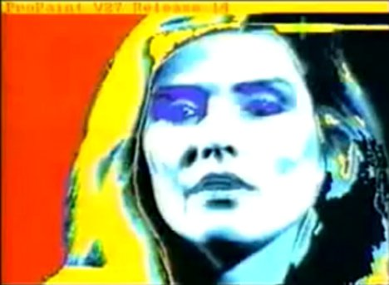
Digital Photography: Digital Photography as Art (1985)
http://www.computerhistory.org/atchm/wp-content/uploads/2013/06/andy-warhol-amiga-computer-painting.jpg

Slide 55
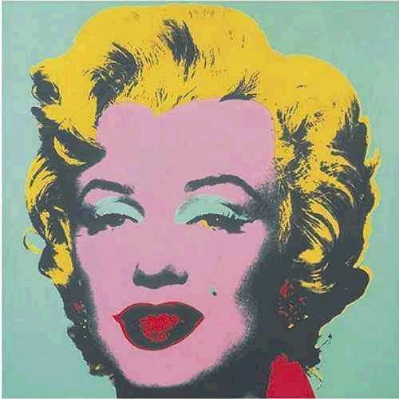
Digital Photography: Digital Photography as Art (1985)
https://s-media-cache-ak0.pinimg.com/736x/e1/cd/63/e1cd63b3692582fb4369c33a177515d1.jpg

Slide 56
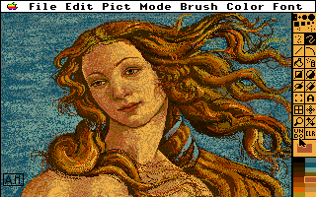
Apple IIGS (1987)
http://www.whatisthe2gs.apple2.org.za/files/DeluxePaintII/ScreenGrab_1/deluxe_paint.gif

Slide 57
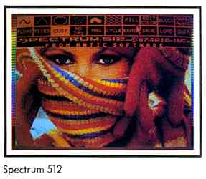
Atari ST (1987)
www.atarimagazines.com/startv2n4/art-8.jpg

Slide 58
Amiga 1000
Juggler Demo – 3D (1985)
http://www.youtube.com/watch?v=g03rcG7F4PU
Newtek Demo – Digitized Images (1987)
http://www.youtube.com/watch?v=PXqmTZMtAj8

Slide 59
Amiga 1000
Amiga Mandala – Amiga AR (1989)
http://www.youtube.com/watch?v=WO-Rwft6h2o
Dragon’s Lair – Ported from Laserdisc (1988)
http://www.youtube.com/watch?v=dSE5LFdOtQI

Slide 60
Amiga 1000
Defender of the Crown – Amiga vs PC
https://www.youtube.com/watch?v=bdrjMcwZ0wk
Shadow of the Beast
https://www.youtube.com/watch?v=w6Osnolfxqw

Slide 61
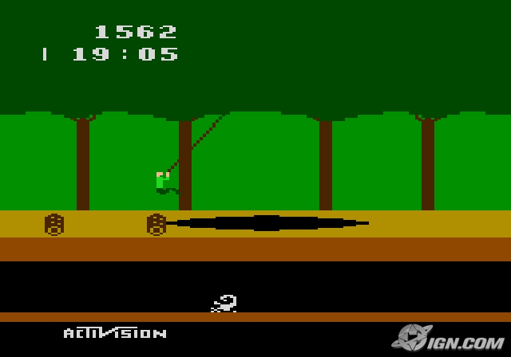
Atari 2600 Pitfall (1982)
http://andafter.org/images/album/screenshot/pitfall-the-mayan-adventure-review-20090413101720509_640w.jpg

Slide 62
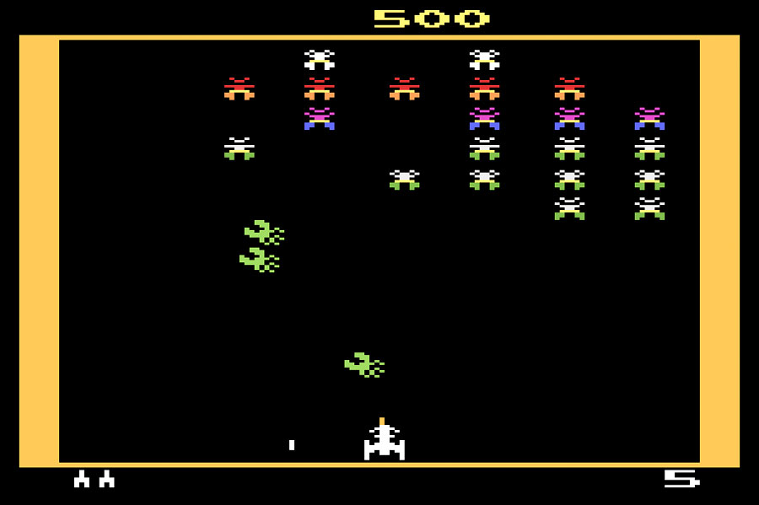
Atari 2600 Galaxian (1983)
http://www.8-bitcentral.com/images/reviews/atari2600/galaxian2600Screen.jpg

Slide 63
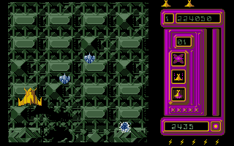
Atari ST Goldrunner (1987)
http://www.vgmuseum.com/pics/Goldrunner%20-%20Ingame.gif

Slide 64
Atari ST
Goldrunner (1987)
http://www.youtube.com/watch?v=f9wjzGOOCag

Slide 65
Multimedia: Early 90’s
Commodore went bankrupt
Atari stopped making computers and game systems
Apple shut down the IIgs line
IBM and Microsoft started to mainstream multimedia
Apple standardized Quicktime

Slide 66
What Happened?
Very Complex. No clear answer.
The Amiga was too far ahead for it’s time
The Amiga was not marketed properly
Amiga, Atari, IIgs lacked mainstream popular support
Multimedia machines were seen as game computers
People bought computers for work not for multimedia

Slide 67
What Happened?
IBM introduced VGA graphics standard in 1987
PC’s became cheaper and were faster
PC clones dominated the market
PC’s had upgradable graphics cards – rise of 3D imaging
Windows 95 standardized PC’s
Mac’s went colour in 1987

Slide 68
Innovation
In reality, Innovation can be defined in different ways
But consider the value
Product Value
Business Value
I would argue however that Innovation in Gaming in the 80’s was focused on creating new things and not specifically on creating new value

Slide 69
Further Reading
Creation Myth Xerox Parc, Apple, and the truth about innovation
http://www.newyorker.com/magazine/2011/05/16/creation-myth
Fumbling the Future: How Xerox invented, then ignored, the first personal computer
http://www.amazon.com/Fumbling-Future-Invented-Personal-Computer/dp/1583482660

Slide 70
Further Reading
The Future Was Here: The Commodore Amiga
http://www.amazon.com/The-Future-Was-Here-Commodore/dp/0262017202
Dealers of Lightning: Xerox Parc and the Dawn of the Computer Age
http://www.amazon.ca/Dealers-Lightning-Xerox-PARC-Computer/dp/0887309895

